Slide 1
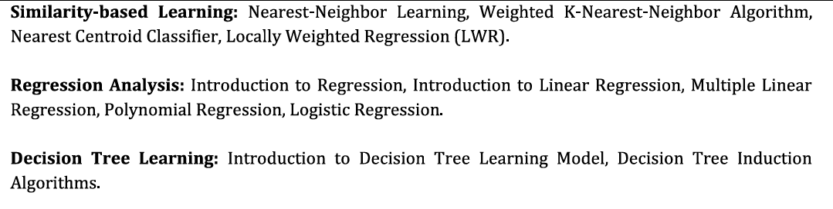
Module 3

Slide 2
Similarity-Based Learning
Similarity-based learning is a learning approach in which a machine predicts the output of a new example by comparing it with previously stored examples instead of learning an explicit mathematical model.
Main Idea:-
If two data points look alike (are similar), they will have the same or similar output/class.
So the system learns by comparison, not by building equations like regression or trees.[Objects that are similar usually belong to the same class.]

Slide 3
Similarity-Based Learning
Basic Idea
The training data is memorized. When a new instance arrives:
Compare the new data with all stored data
Measure similarity (or distance)
Choose the most similar examples
Assign the same class/output
This is why it is also called:
Instance-based learning
Memory-based learning
Lazy learning

Slide 4
How Similarity is Measured
The algorithm calculates distance between two data points.
Euclidean Distance (most used)
Manhattan Distance
Cosine Similarity

Slide 5
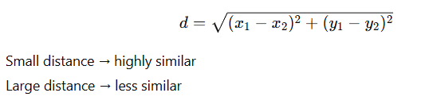
Euclidean Distance
Distance between two points in space.

Slide 6
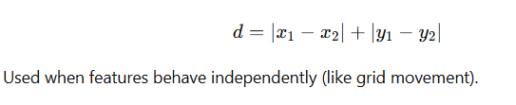
Manhattan Distance

Slide 7
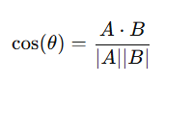
Cosine Similarity
Used for text/documents.
Used in:
search engines
document classification
recommendation systems

Slide 8
Main Algorithm: k-Nearest Neighbor (KNN)
The most important similarity-based learning algorithm is KNN.
Working Steps
Choose k (number of neighbors)
Compute distance between new sample and all training samples
Select the k closest data points
Majority class becomes prediction

Slide 9
Example
Training Data
Temperature | Humidity | Play Cricket
Hot | High | No
Cool | Normal | Yes
Mild | Normal | Yes
New case: Mild & High
The nearest examples are checked → majority = Yes
Prediction → Play Cricket = Yes
The system did not learn rules — it compared similarity.

Slide 10
Characteristics
Instance-based learning
Memory-based learning
Lazy learning (no training phase)

Slide 11
Advantages
Very simple to understand
No training time
Works well for small datasets
Naturally handles multi-class problems

Slide 12
Dis-advantages
Slow prediction (checks all data)
Needs large memory
Sensitive to noise
Choosing proper k value is difficult

Slide 13
Comparison with Model-Based Learning
Model-Based Learning | Similarity-Based Learning
Learns a mathematical model | Stores examples
Fast prediction | Slow prediction
Needs training phase | No training phase
Example: Decision Tree, Regression | Example: KNN

Slide 14
Real Life Example
Face recognition (matching similar faces)
Netflix/Amazon recommendations
Spam detection
Handwriting recognition
Medical diagnosis (matching similar patient history)

Slide 15
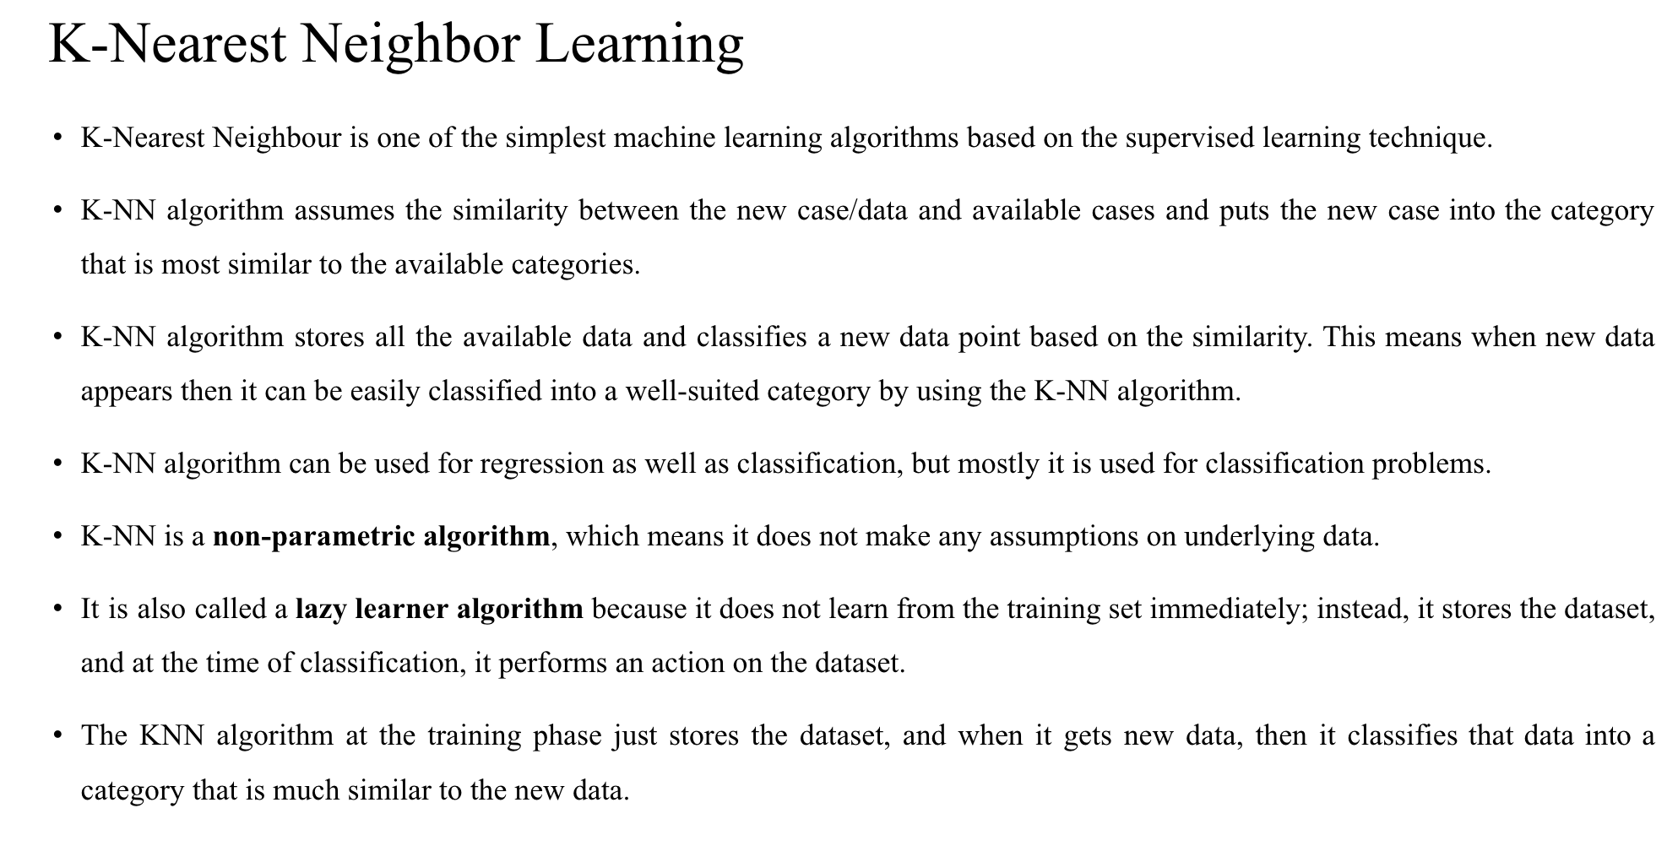

Slide 16
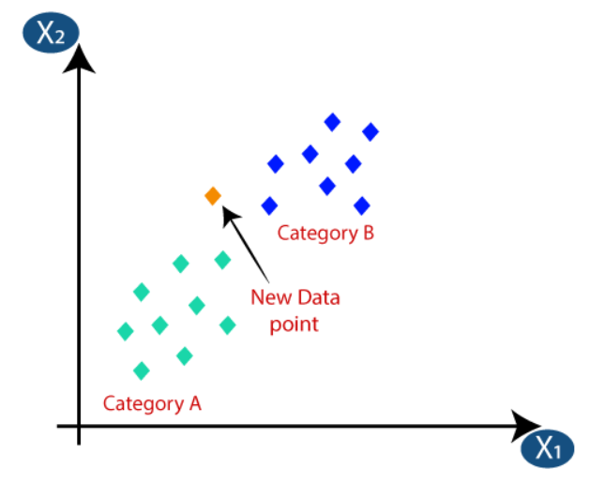

Slide 17
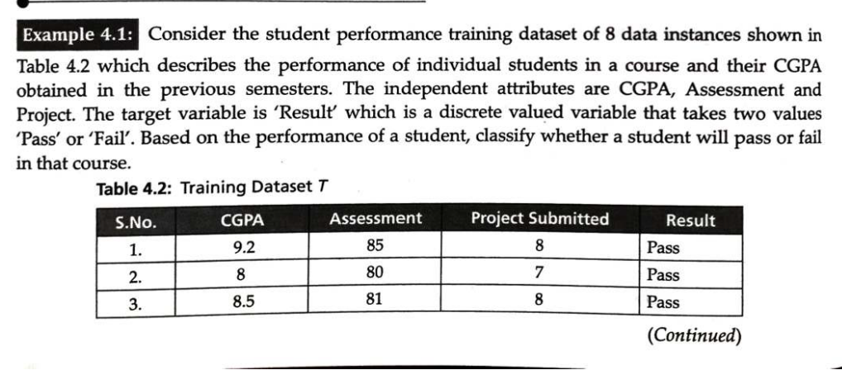
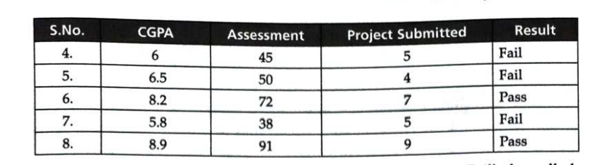

Slide 18
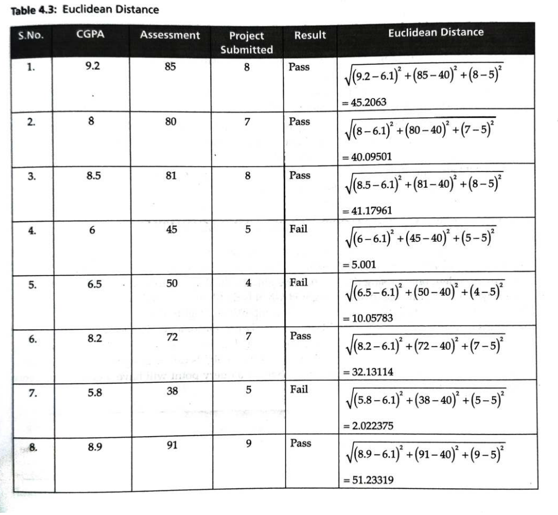

Slide 19
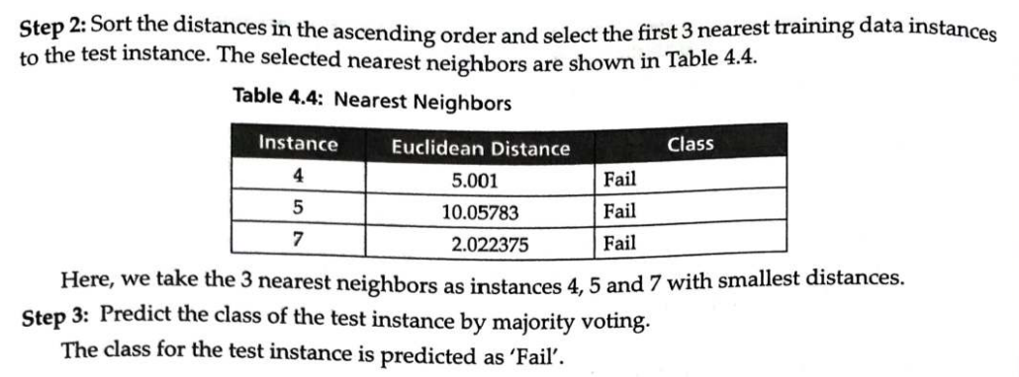

Slide 20
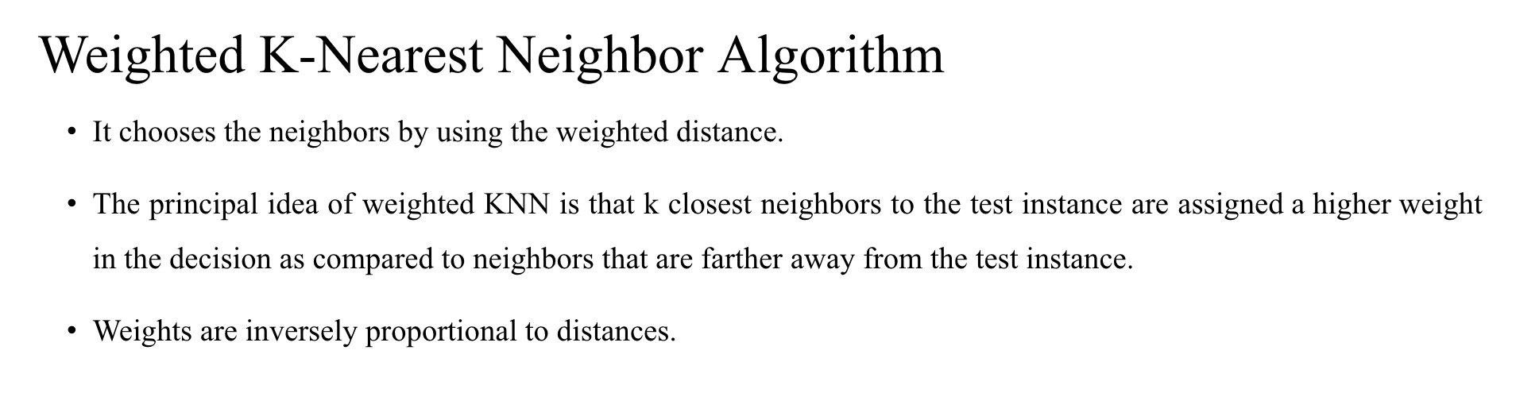
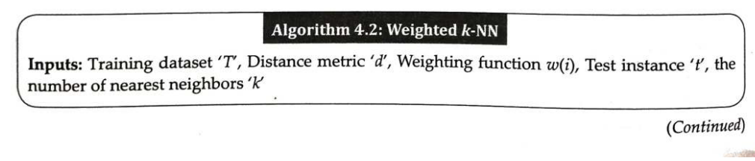

Slide 21
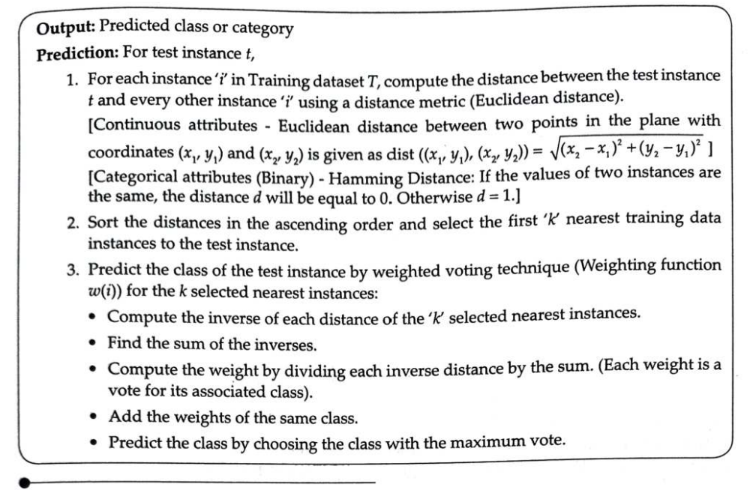

Slide 22
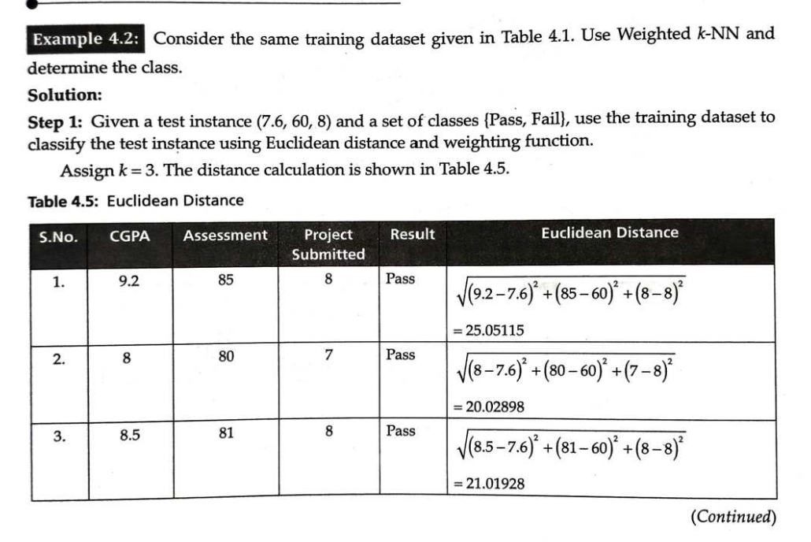

Slide 23
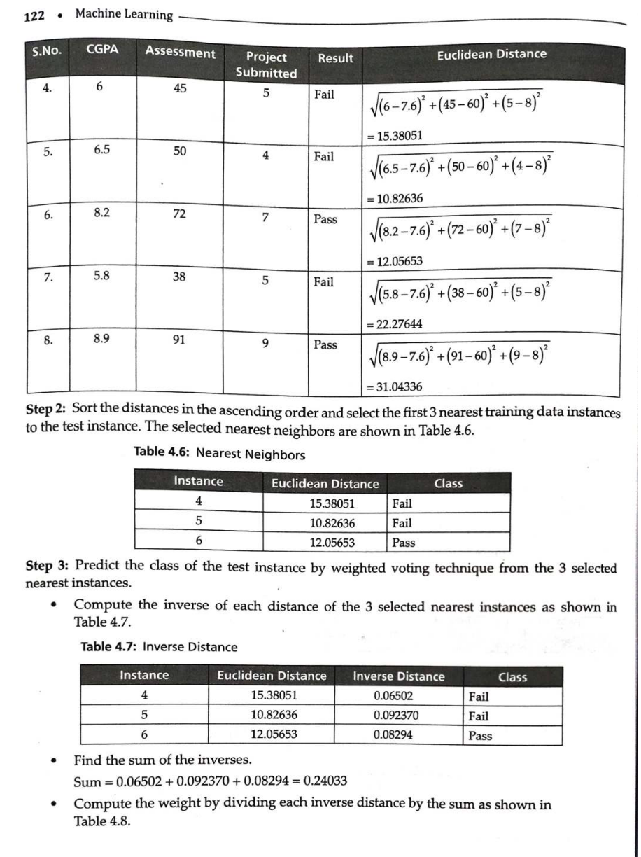

Slide 24
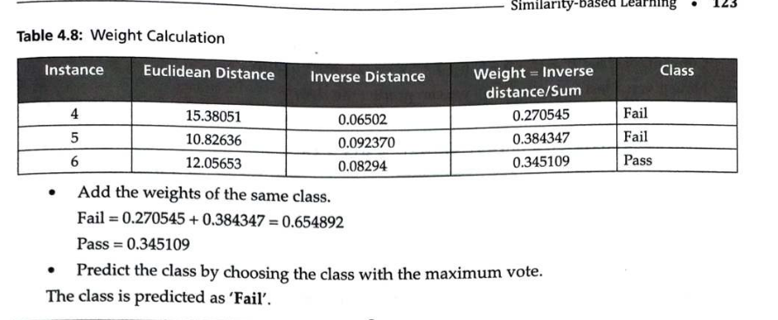

Slide 25
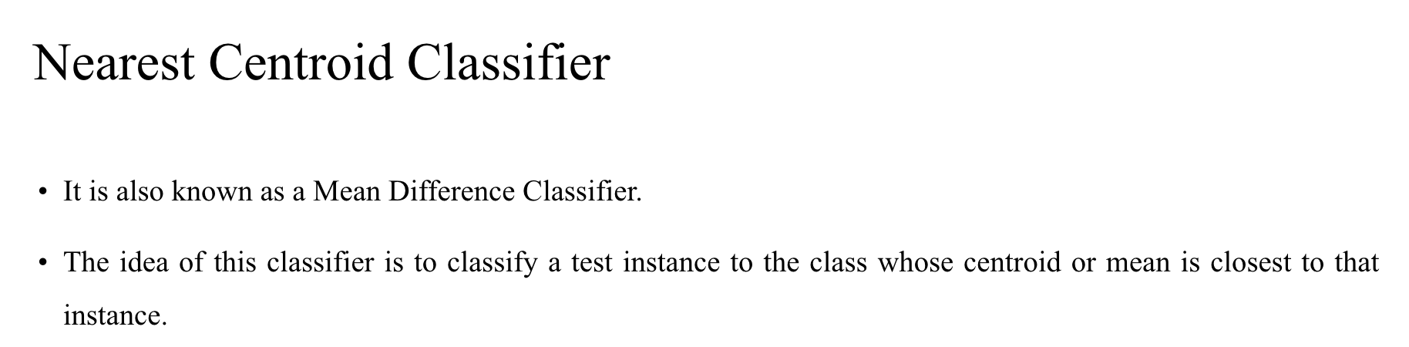
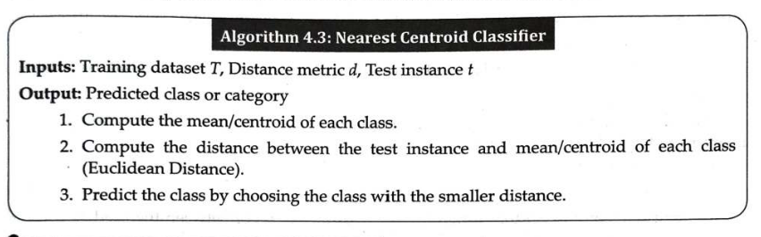

Slide 26
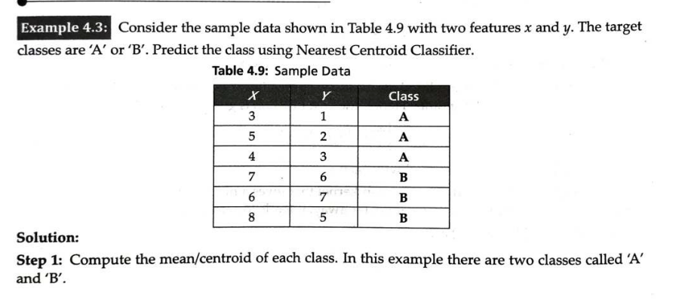

Slide 27
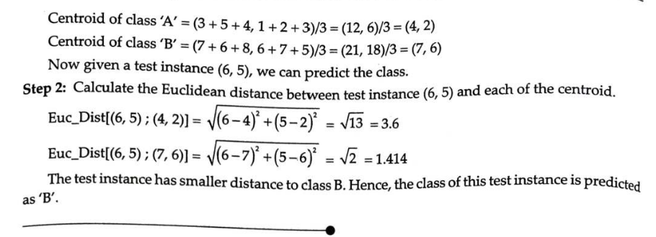

Slide 28
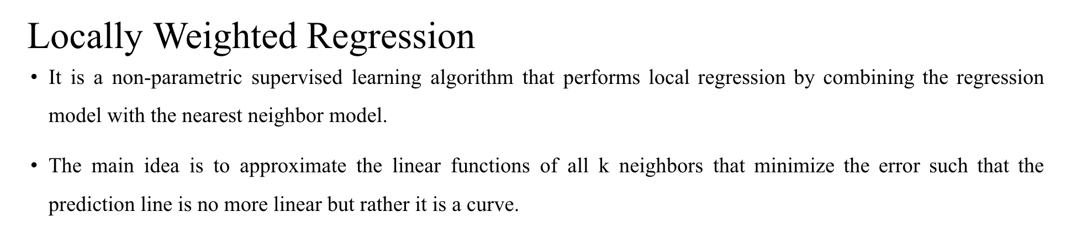
LWR combines linear regression with nearest neighbor concepts.
When predicting a value, the algorithm:
  Finds points near the test instance
  Assigns higher weights to closer points
  Fits a linear regression using these weighted points
So, the prediction curve becomes smooth and flexible (curved) rather than a single straight line.

Slide 29
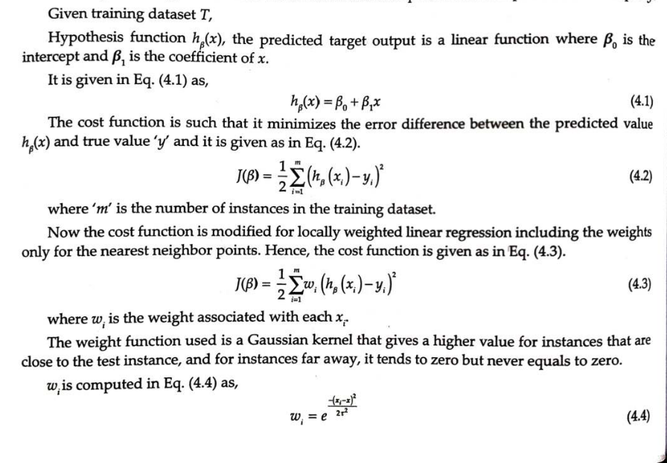

Slide 30
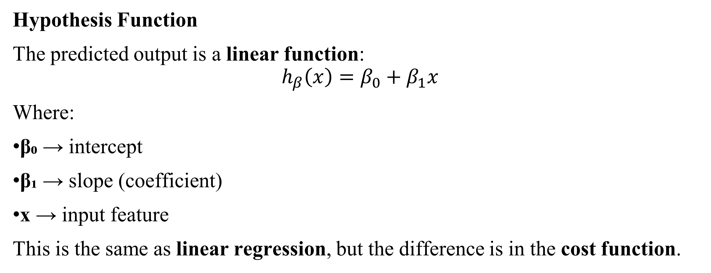
Hypothesis Function
The predicted output is a linear function:
$$h_{β}\left(x\right)=β_{0}+β_{1}x$$
Where:
β₀ → intercept
β₁ → slope (coefficient)
x → input feature
This is the same as linear regression, but the difference is in the cost function.

Slide 31
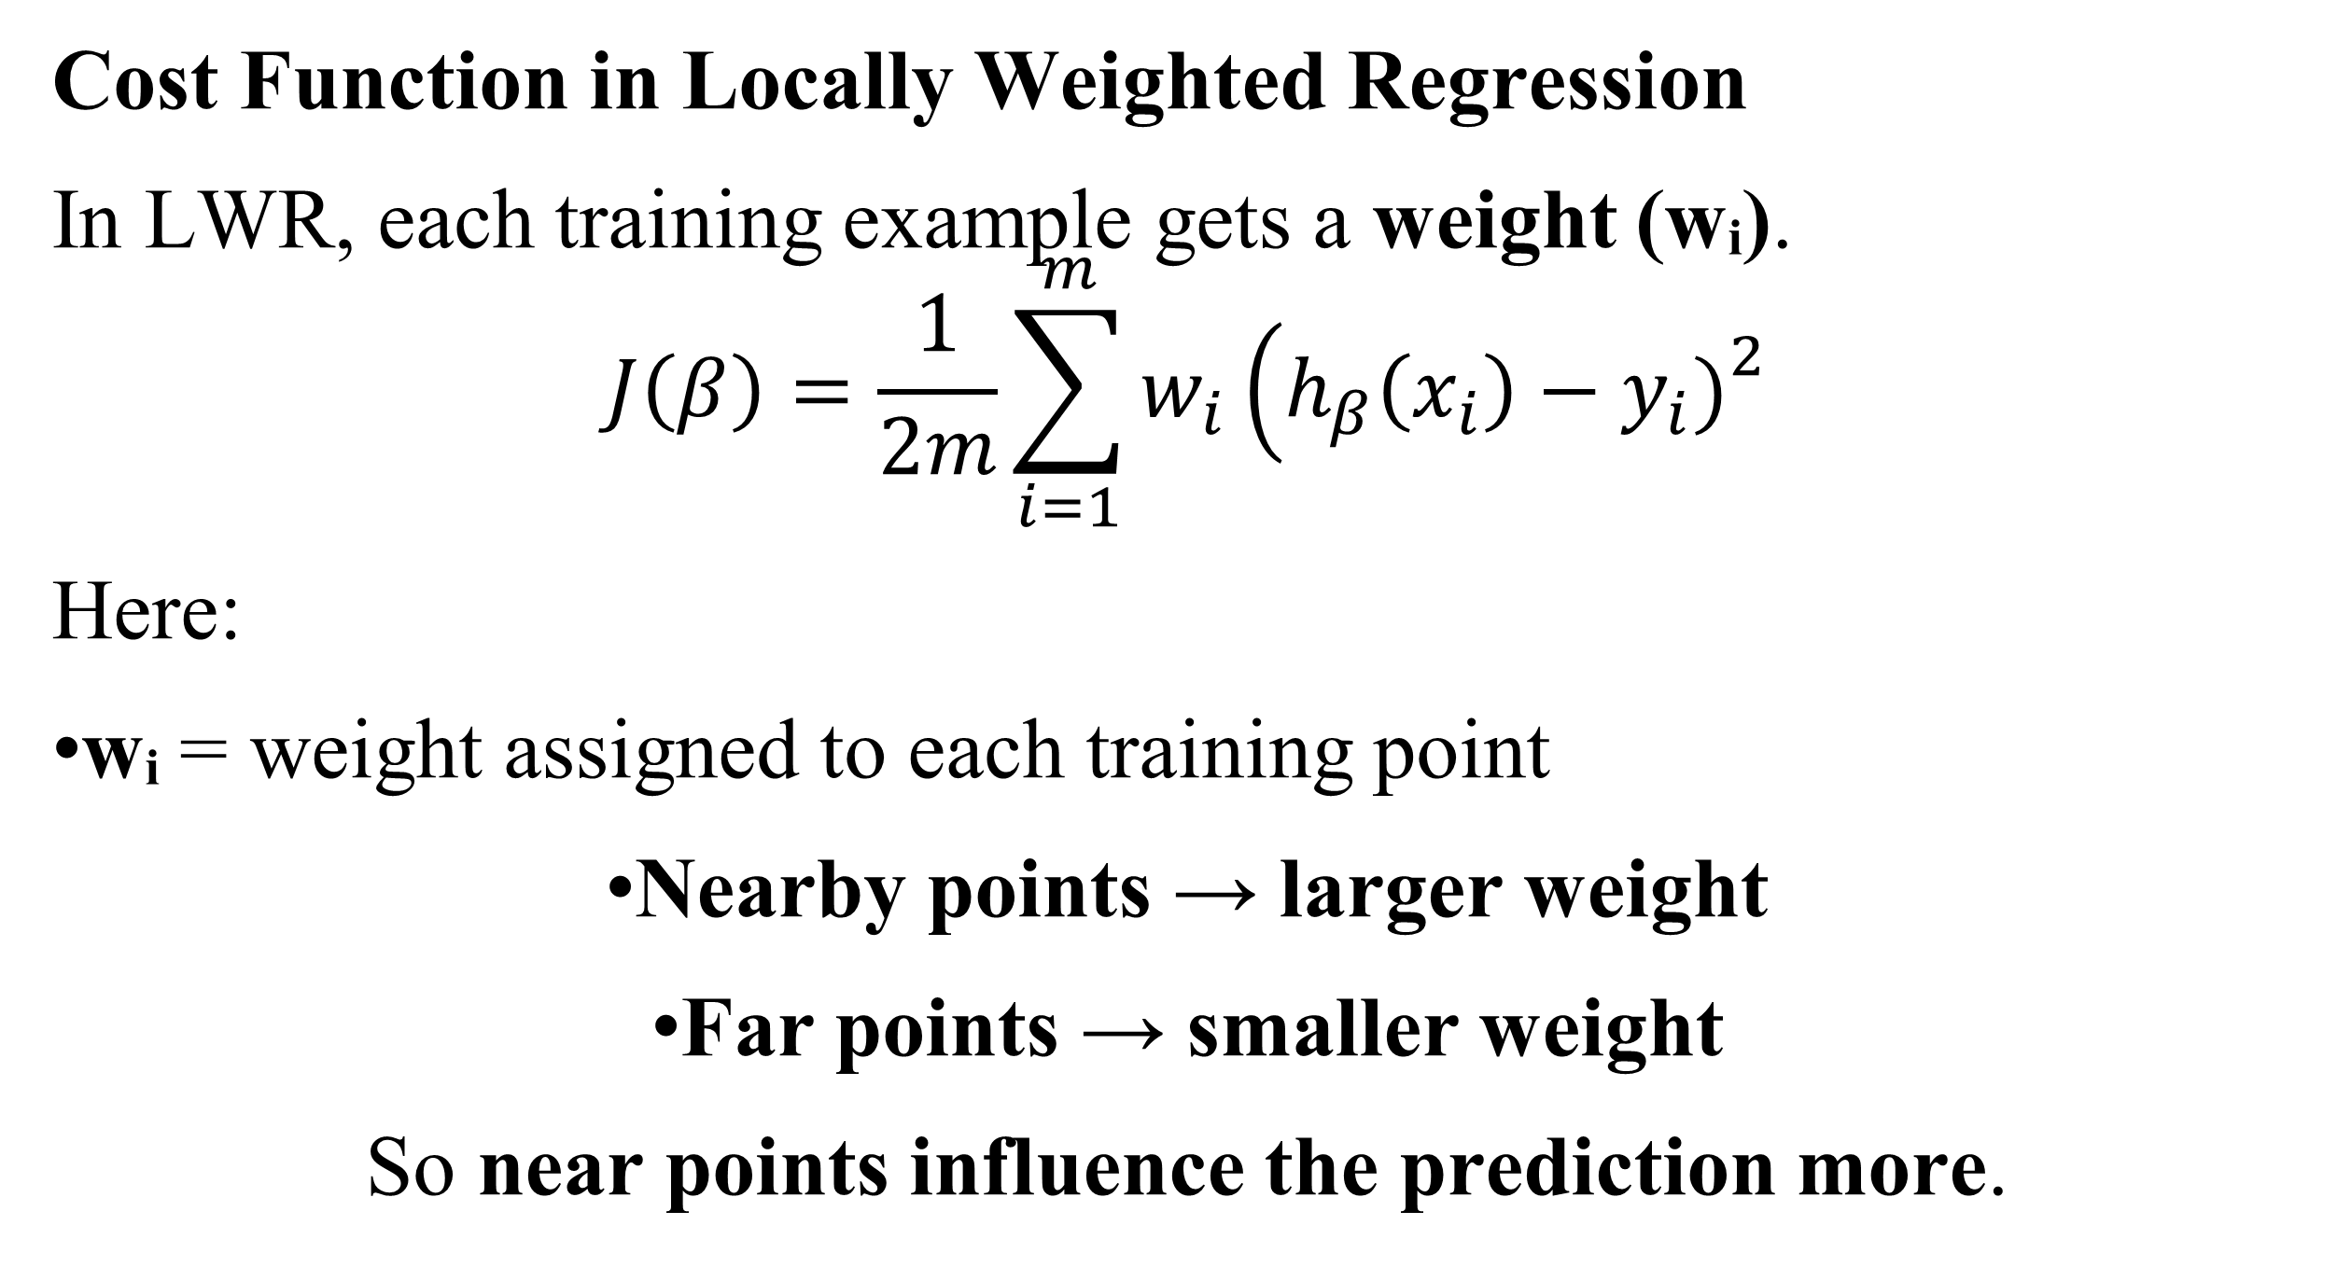
Cost Function in Locally Weighted Regression
In LWR, each training example gets a weight (wᵢ).
$$J\left(β\right)=\frac{1}{2m}\sum_{i=1}^{m}{w_{i}}\left(h_{β}\left(x_{i}\right)−y_{i}{\left.)\right.}^{2}\right.$$
Here:
wᵢ = weight assigned to each training point
Nearby points → larger weight
Far points → smaller weight
So near points influence the prediction more.

Slide 32
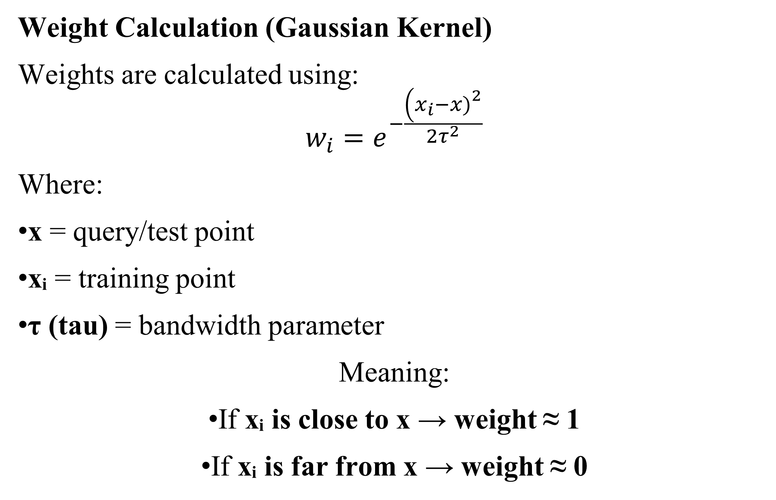
Weight Calculation (Gaussian Kernel)
Weights are calculated using:
$$w_{i}=e^{−\frac{\left(x_{i}−x{\left.)\right.}^{2}\right.}{2τ^{2}}}$$
Where:
x = query/test point
xᵢ = training point
τ (tau) = bandwidth parameter
Meaning:
If xᵢ is close to x → weight ≈ 1
If xᵢ is far from x → weight ≈ 0

Slide 33
Example
Simple Intuition Example
Suppose we want to predict house price for 1200 sq ft.
Dataset contains houses of:
800 sq ft
1000 sq ft
1500 sq ft
3000 sq ft
In LWR:
1000 and 1500 sq ft houses get higher weights
3000 sq ft house gets very small weight
So prediction is mainly influenced by nearby houses.

Slide 34
LWR
Advantages
Flexible model
Captures non-linear patterns
More accurate for local predictions
Disadvantages
Computationally expensive
Must recompute regression for every prediction
Needs large memory
Locally Weighted Regression predicts values by fitting a linear model using nearby data points with higher weights.

Slide 35
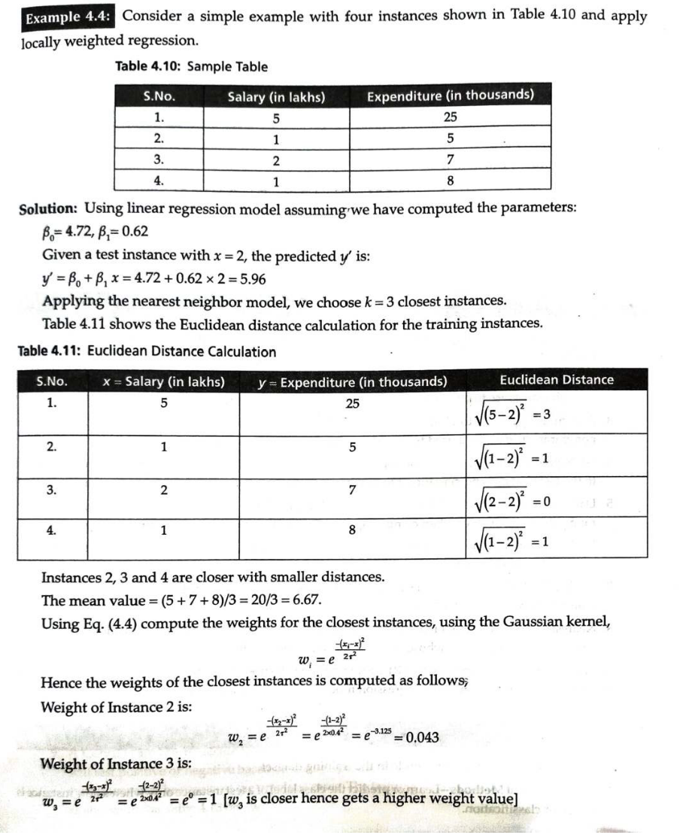

Slide 36
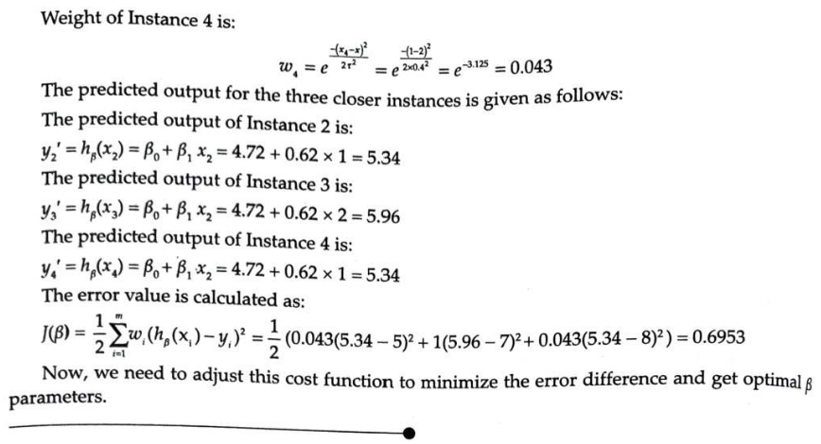

Slide 37
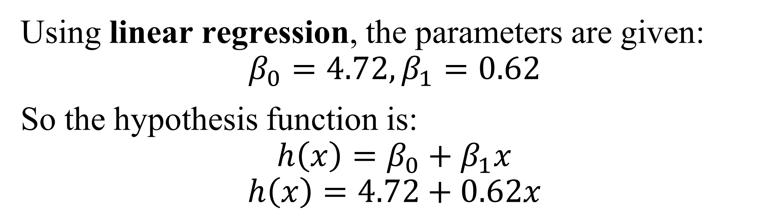
1 Step :-Given Dataset
S.No | Salary (x) in lakhs | Expenditure (y) in thousands
1 | 5 | 25
2 | 1 | 5
3 | 2 | 7
4 | 1 | 8
Using linear regression, the parameters are given:
$$β_{0}=4.72, β_{1}=0.62$$
So the hypothesis function is:
$$h\left(x\right)=β_{0}+β_{1}x$$
$$h\left(x\right)=4.72+0.62x$$

Slide 38
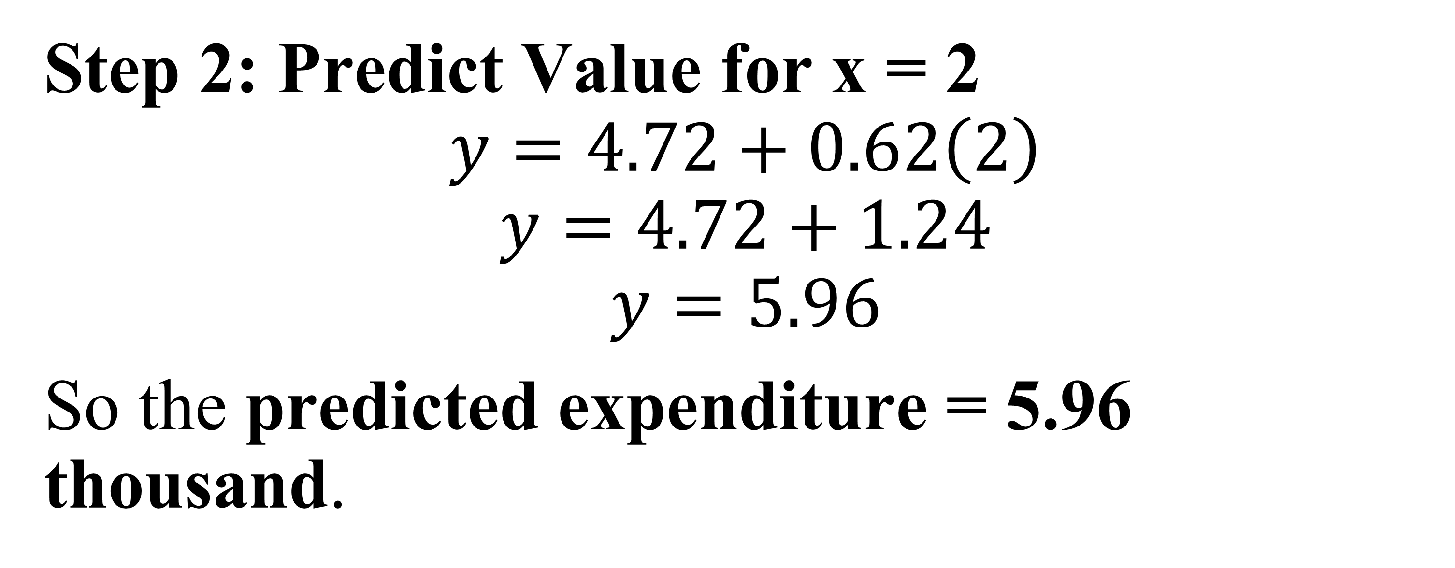
Step 2: Predict Value for x = 2
$$y=4.72+0.62\left(2\right)$$
$$y=4.72+1.24$$
$$y=5.96$$
So the predicted expenditure = 5.96 thousand.

Slide 39
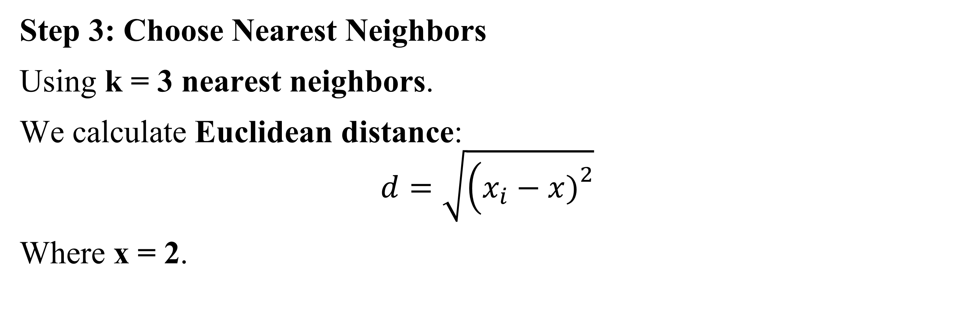
Step 3: Choose Nearest Neighbors
Using k = 3 nearest neighbors.
We calculate Euclidean distance:
$$d=\sqrt{\left(x_{i}−x{\left.)\right.}^{2}\right.}$$
Where x = 2.
Instance | Salary | Distance
1 | 5 | √(5−2)² = 3
2 | 1 | √(1−2)² = 1
3 | 2 | √(2−2)² = 0
4 | 1 | √(1−2)² = 1

Slide 40
Step 4: Select 3 Closest Points
Closest instances:
Instance | Salary | Expenditure
2 | 1 | 5
3 | 2 | 7
4 | 1 | 8

Slide 41
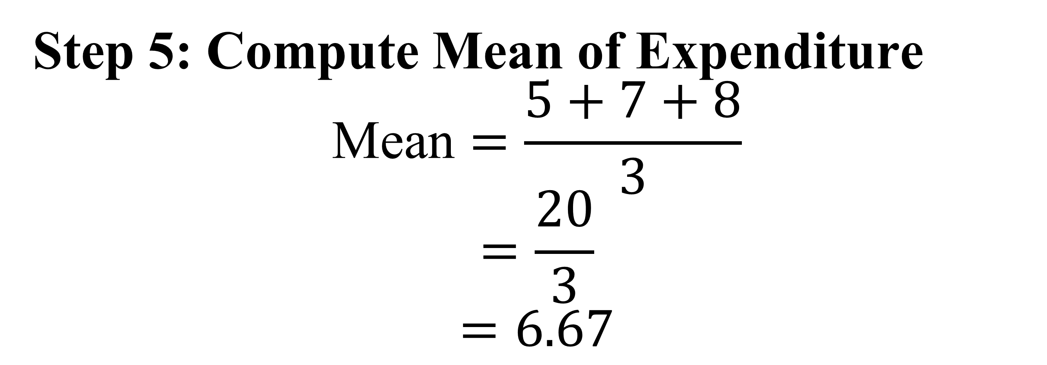
Step 5: Compute Mean of Expenditure
$$\text{Mean}=\frac{5+7+8}{3}$$
$$=\frac{20}{3}$$
$$=6.67$$

Slide 42
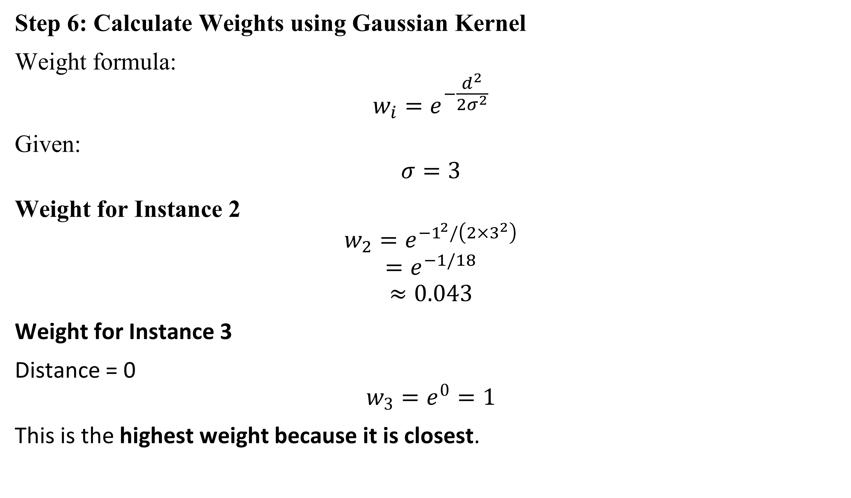
Step 6: Calculate Weights using Gaussian Kernel
Weight formula:
$$w_{i}=e^{−\frac{d^{2}}{2σ^{2}}}$$
Given:
$$σ=3$$
Weight for Instance 2
$$w_{2}=e^{−1^{2}/\left(2×3^{2}\right)}$$
$$=e^{−1/18}$$
$$≈0.043$$
Weight for Instance 3
Distance = 0
$$w_{3}=e^{0}=1$$
This is the highest weight because it is closest.

Slide 43
Step 7: Interpretation
Instance 3 gets the highest weight because distance = 0.
Instances 2 and 4 get smaller weights.
The final prediction is influenced more by the closest instance.
Locally Weighted Regression:
Finds nearest neighbors
Assigns higher weights to closer points
Uses them to predict the output locally

Slide 44
Regression is a method used to predict a numerical value by analyzing the relationship between variables.
Study Hours (x) | Marks (y)
2 | 40
4 | 60
6 | 80
Using regression, we can predict:
If a student studies 5 hours, the predicted marks may be around 70.
Real-Life Examples
Predicting house prices
Predicting salary based on experience
Predicting sales in a business
Predicting temperature or rainfall

Slide 45
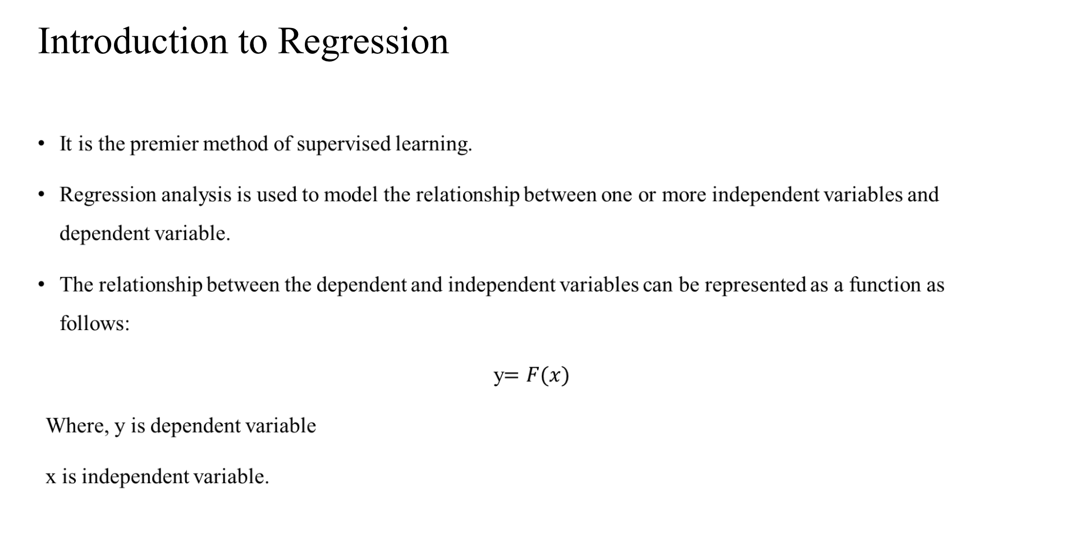

Slide 46
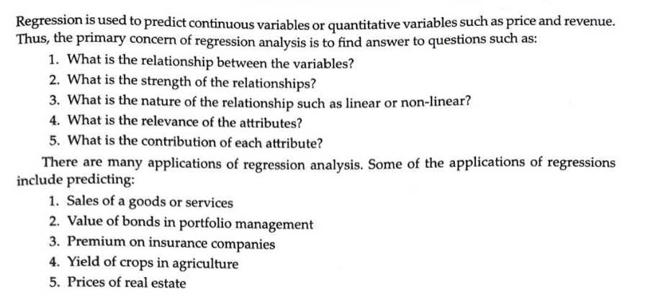

Slide 47
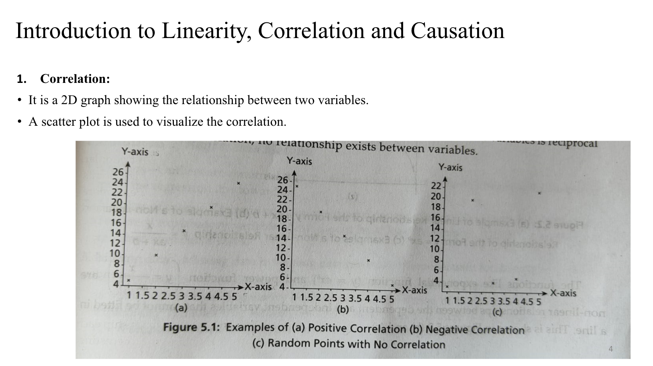

Slide 48
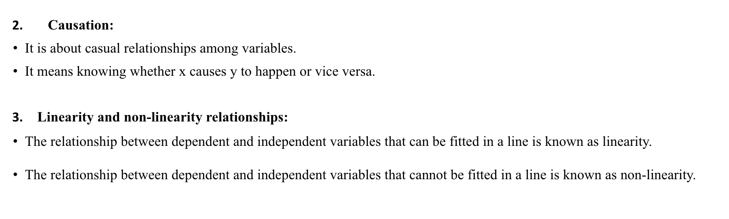
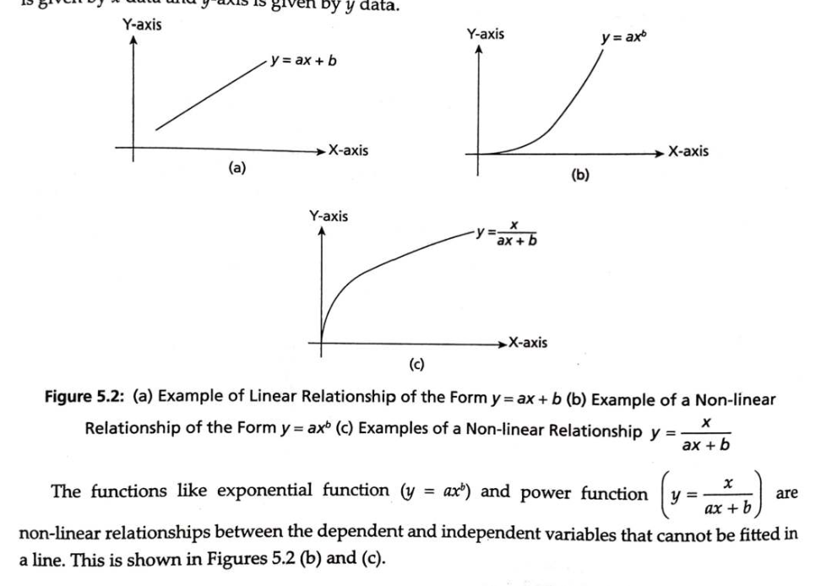

Slide 49
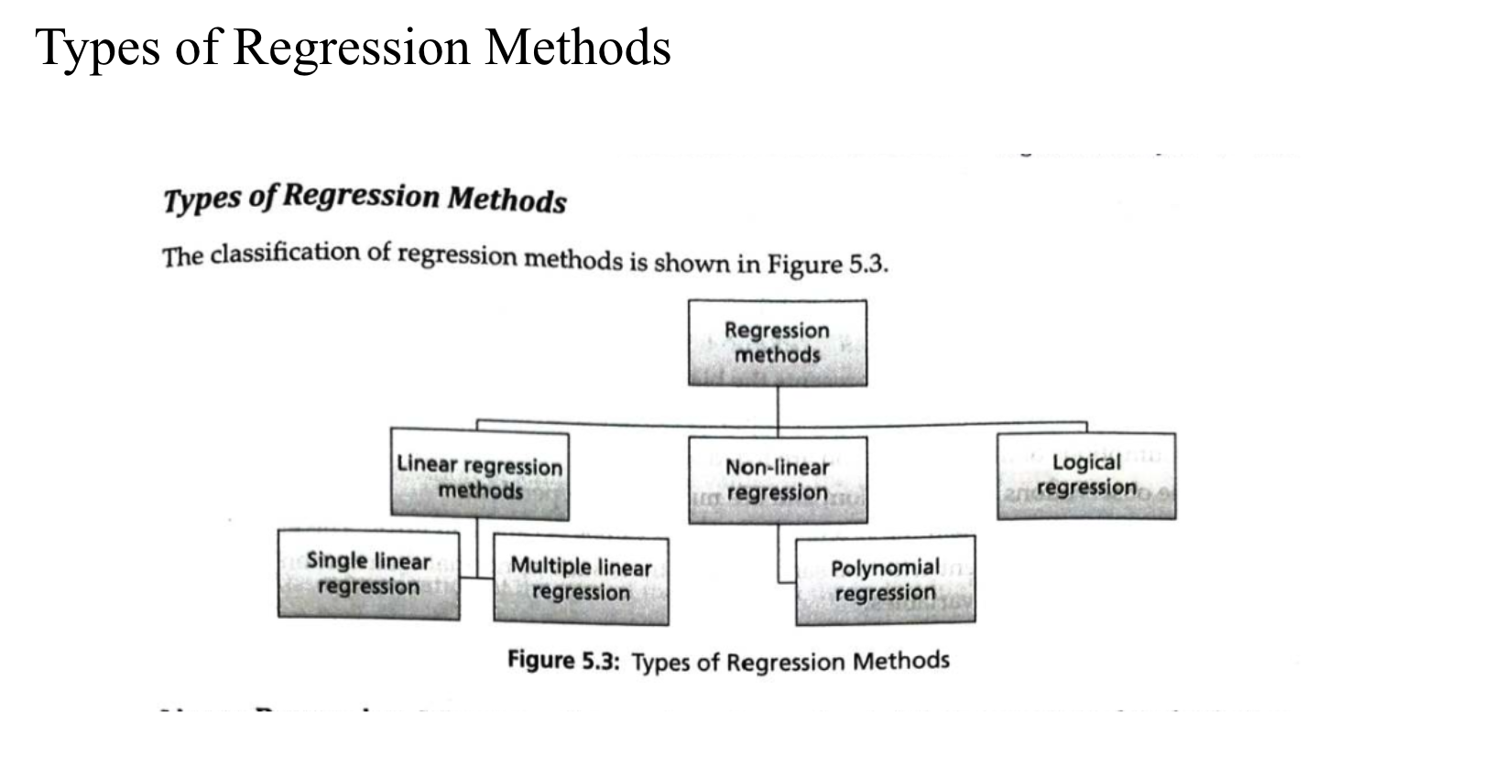

Slide 50
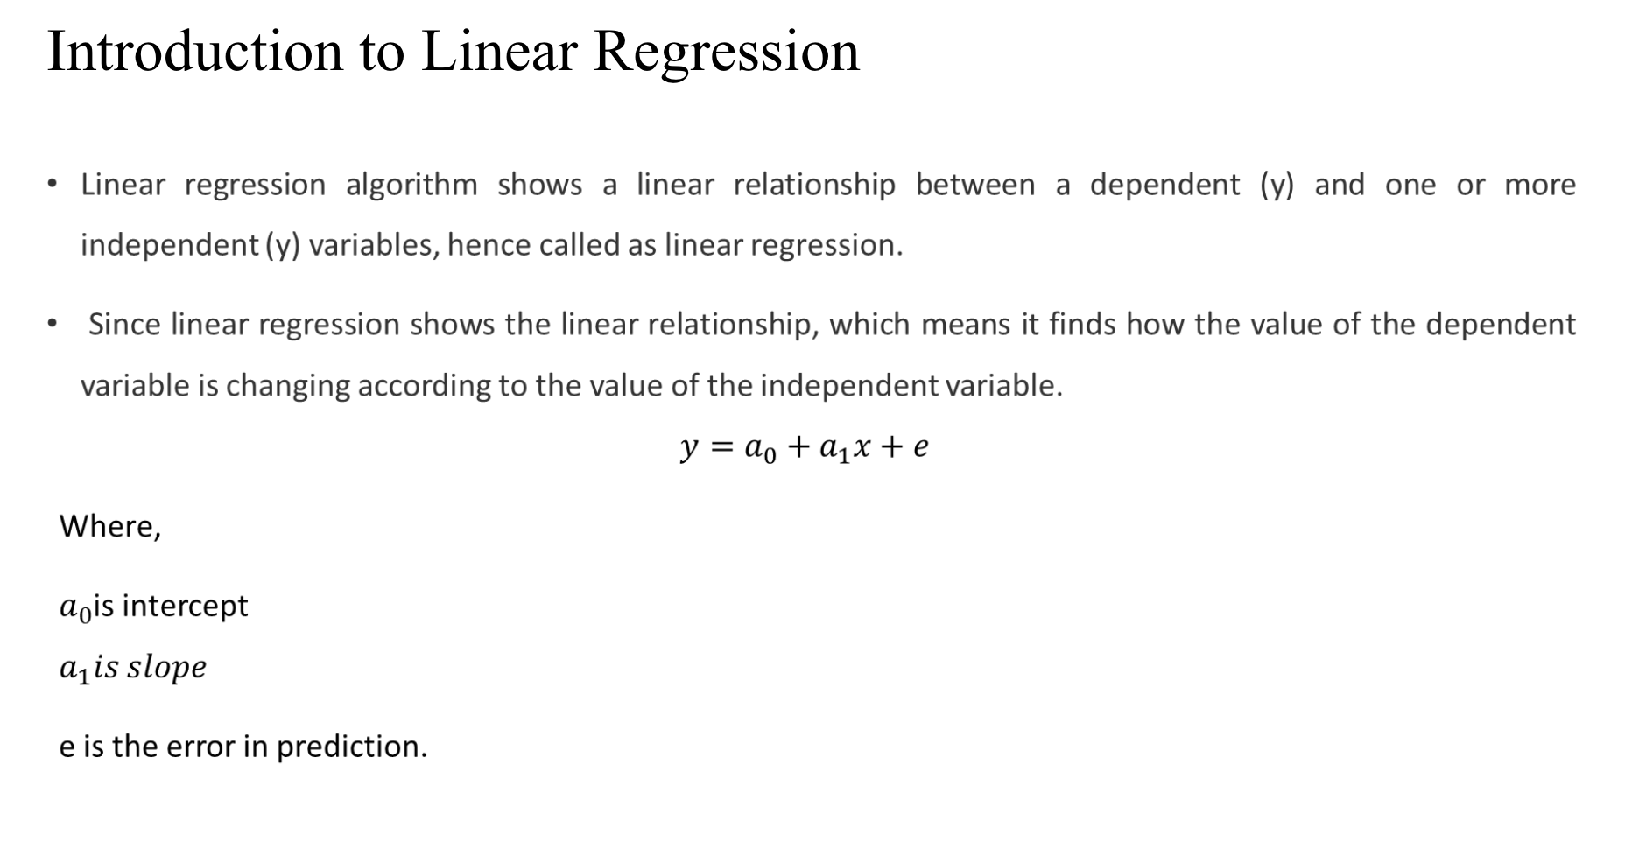

Slide 51
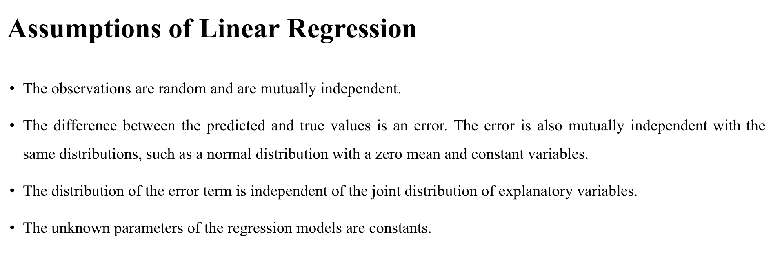

Slide 52
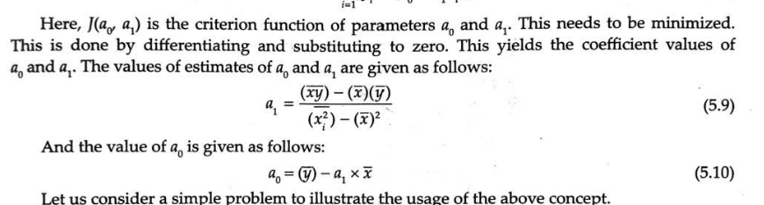
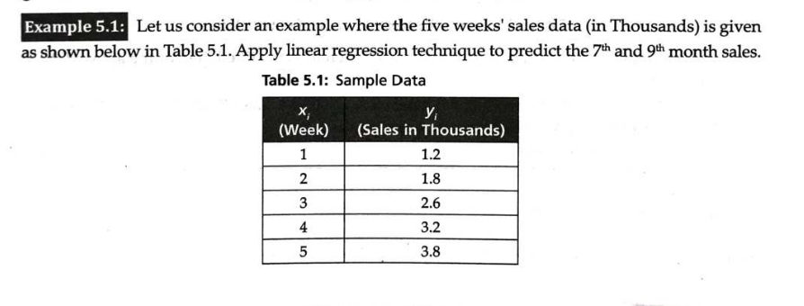

Slide 53
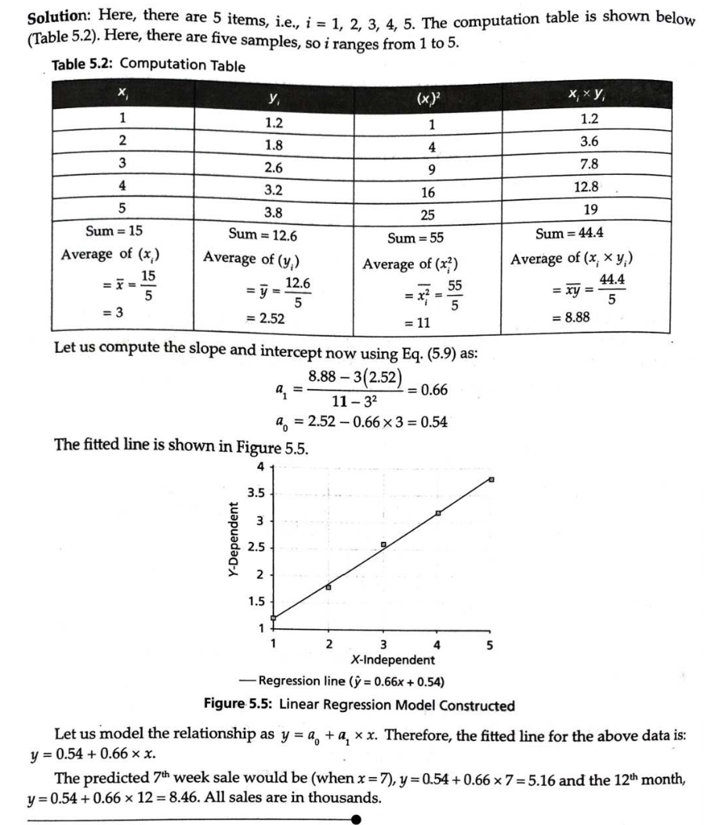

Slide 54
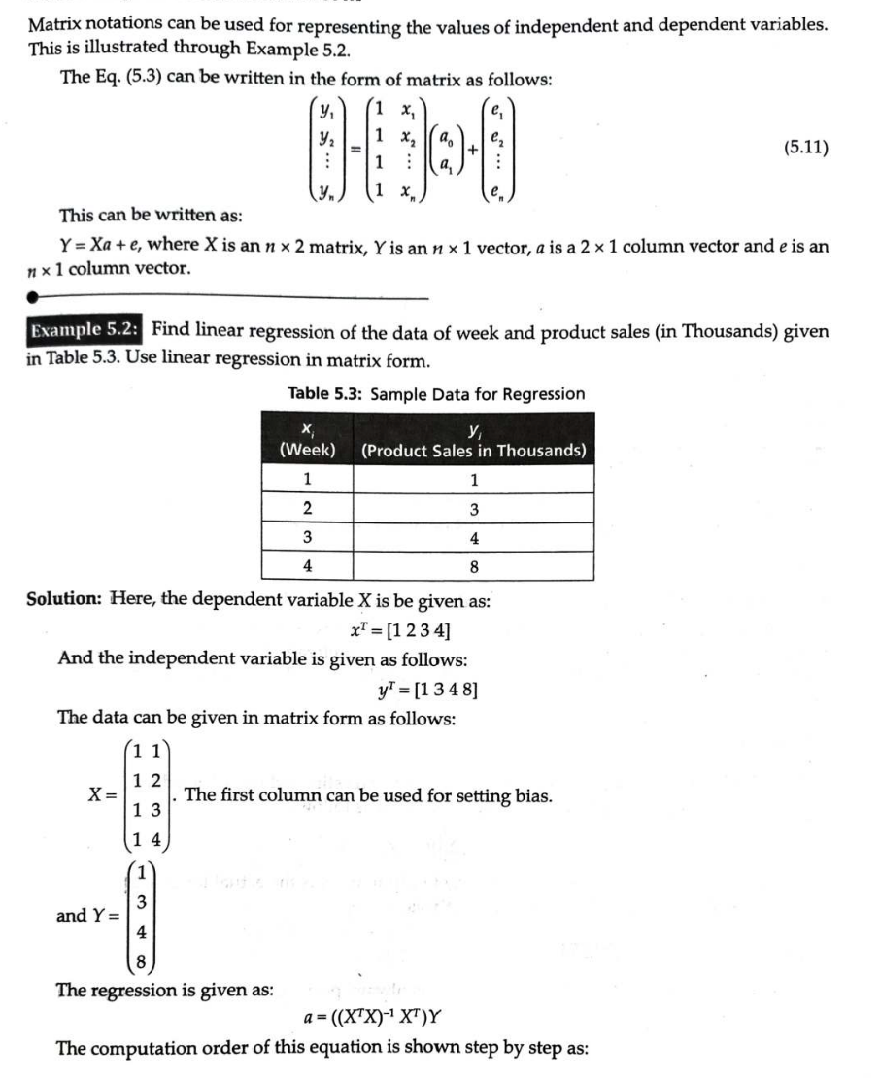
Linear Regression in Matrix Form

Slide 55
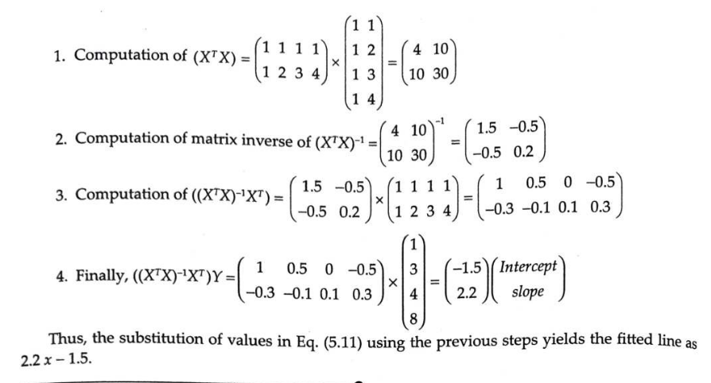

Slide 56
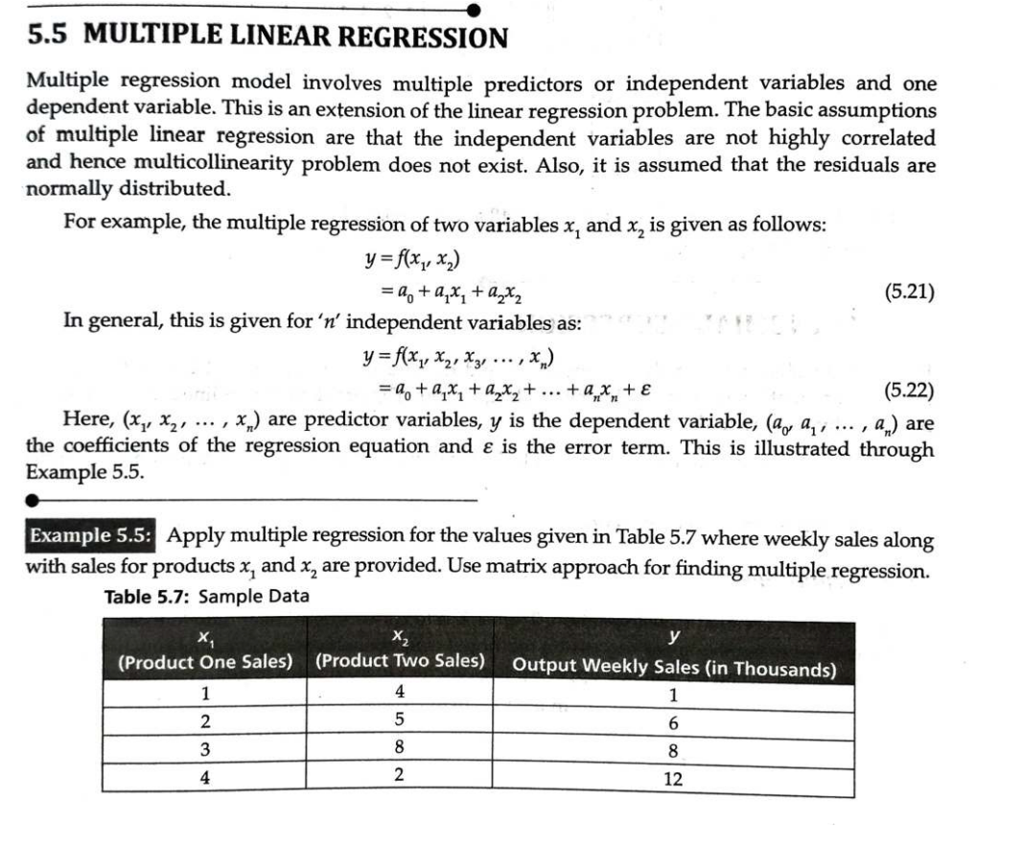
MULTIPLE LINEAR REGRESSION

Slide 57
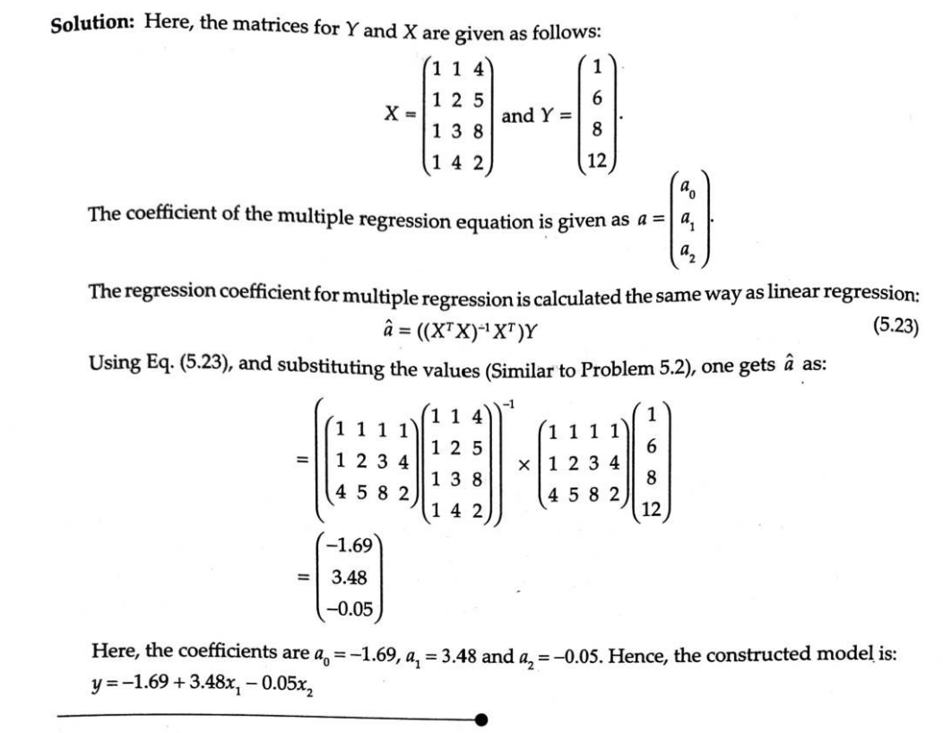

Slide 58
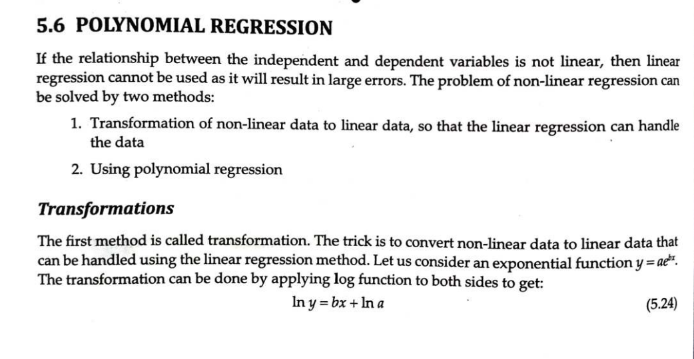
POLYNOMIAL REGRESSION

Slide 59
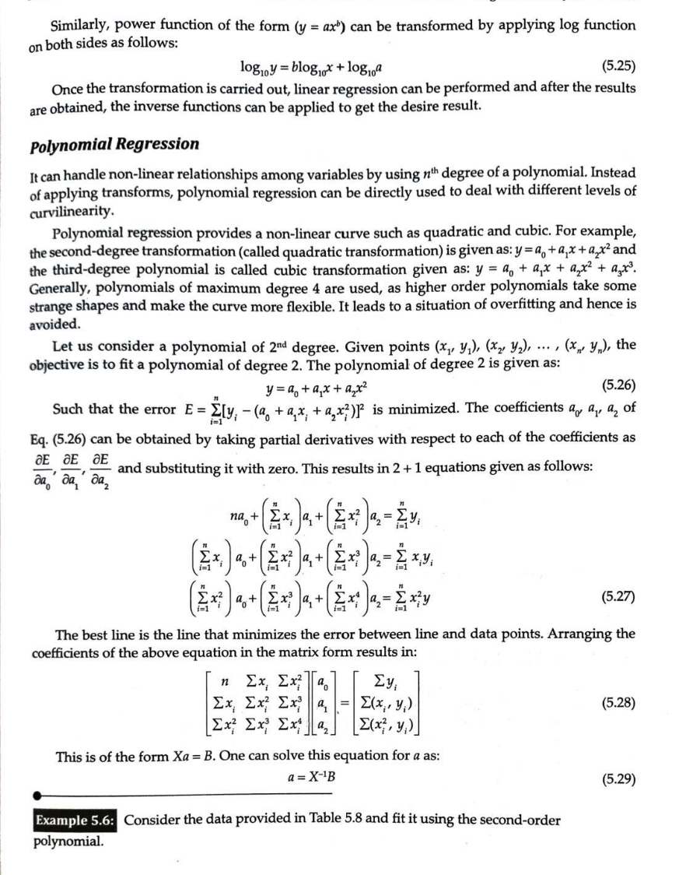

Slide 60
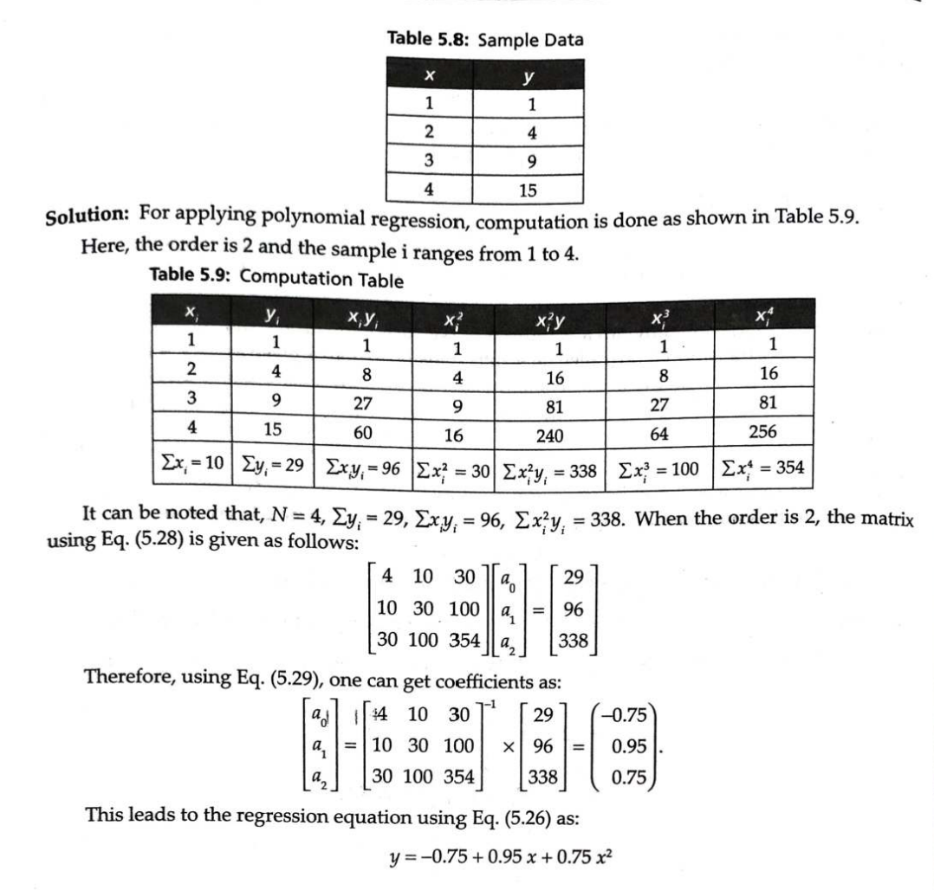

Slide 61

LOGISTIC REGRESSION

Slide 62


Slide 63


Slide 64


Slide 65


Slide 66


Slide 67


Slide 68


Slide 69


Slide 70

FUNDAMENTALS OF ENTROPY

Slide 71


Slide 72


Slide 73


Attribute Selection Measure: Information Gain
1. ID3 Algorithm
$$InformationGain=E−E(A)$$

Slide 74


Slide 75



Slide 76



Slide 77

Attribute Selection Measure: Gain Ratio
1. C4.5 Algorithm

Slide 78



Slide 79



Slide 80


Slide 81

C4.5 Algorithm Dealing with Continuous Attributes

Slide 82


Slide 83


Slide 84


Attribute Selection Measure: Gini Index
1. CART (Classification and Regression Trees) Algorithm

Slide 85



Slide 86


Regression Trees

Slide 87


Slide 88


Slide 89


Slide 90


Slide 91


